Slide 1
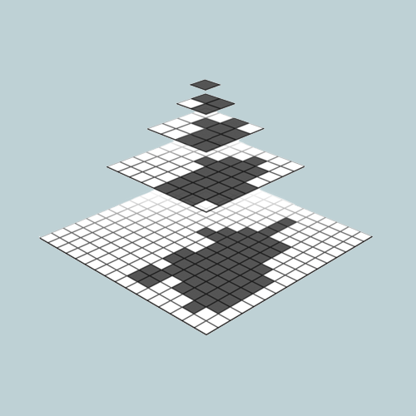

High Quality Software and Hardware Virtual Textures
J.M.P. van Waveren
Lead Technology Programmer
id Software

Slide 2
Software Virtual Textures
Solving issues and
achieving high quality.

Slide 3
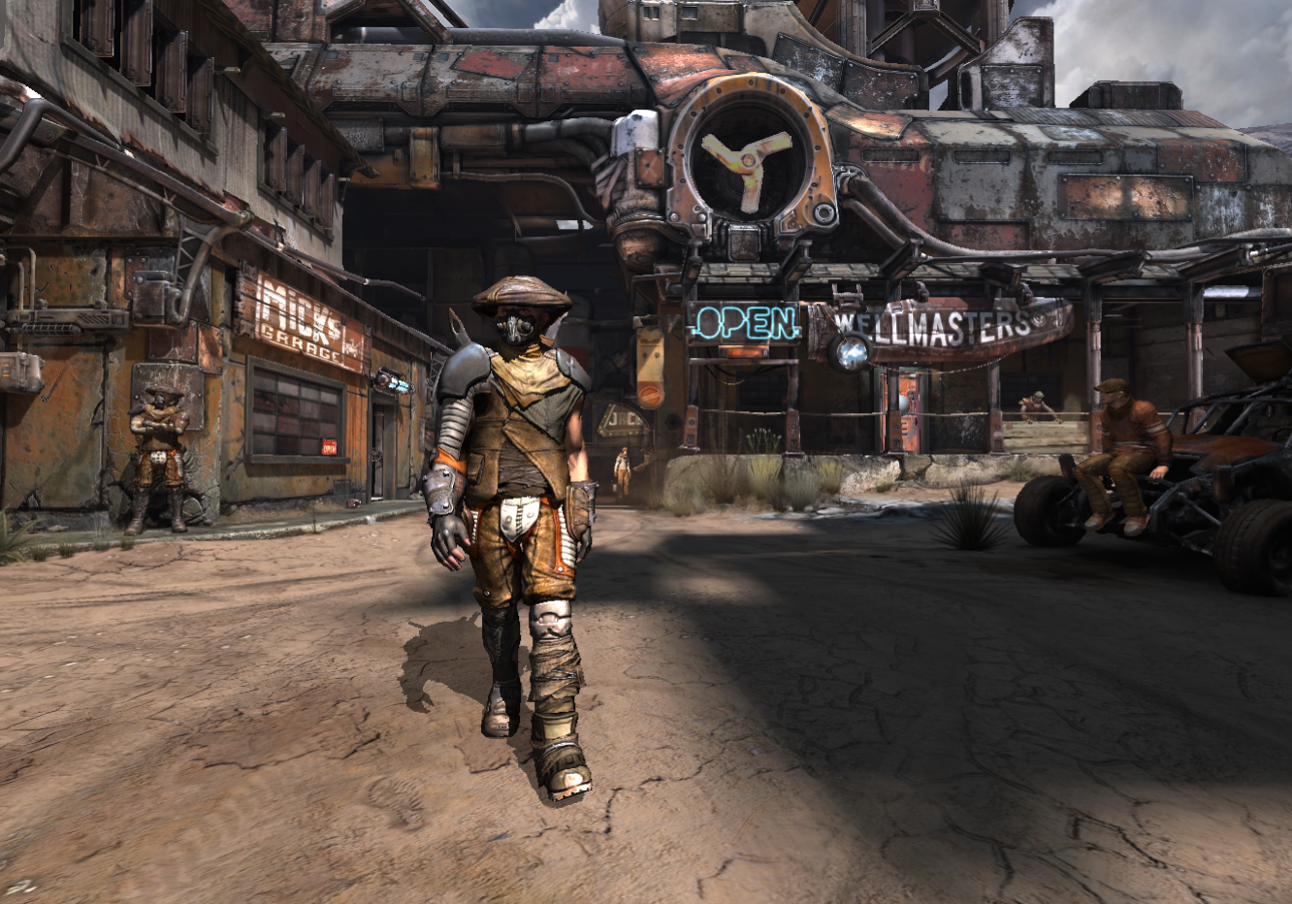
Software Virtual Textures in RAGE
Notes:
A scene from the game RAGE.

Slide 4
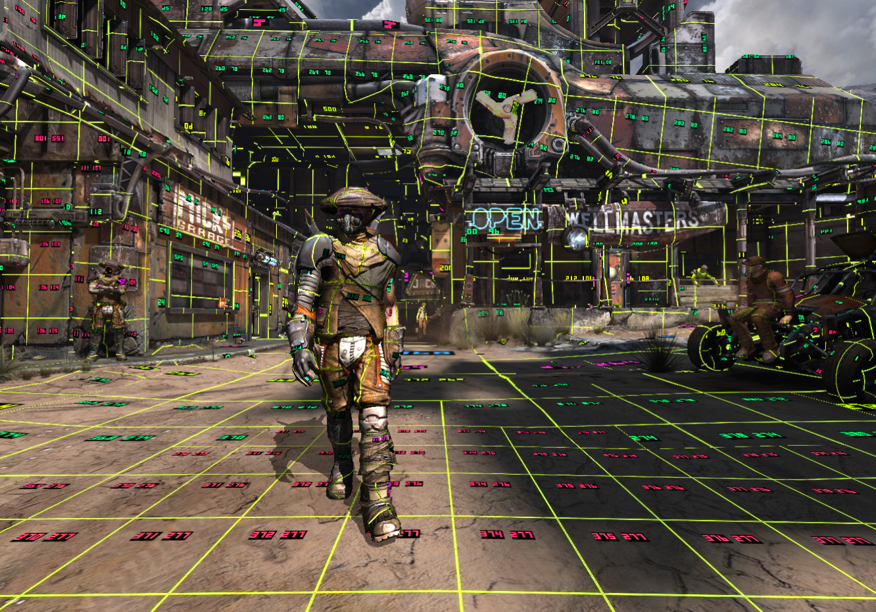
Software Virtual Textures in RAGE
Notes:
The game implements a debug mode where virtual texture pages are highlighted and numbered.

Slide 5
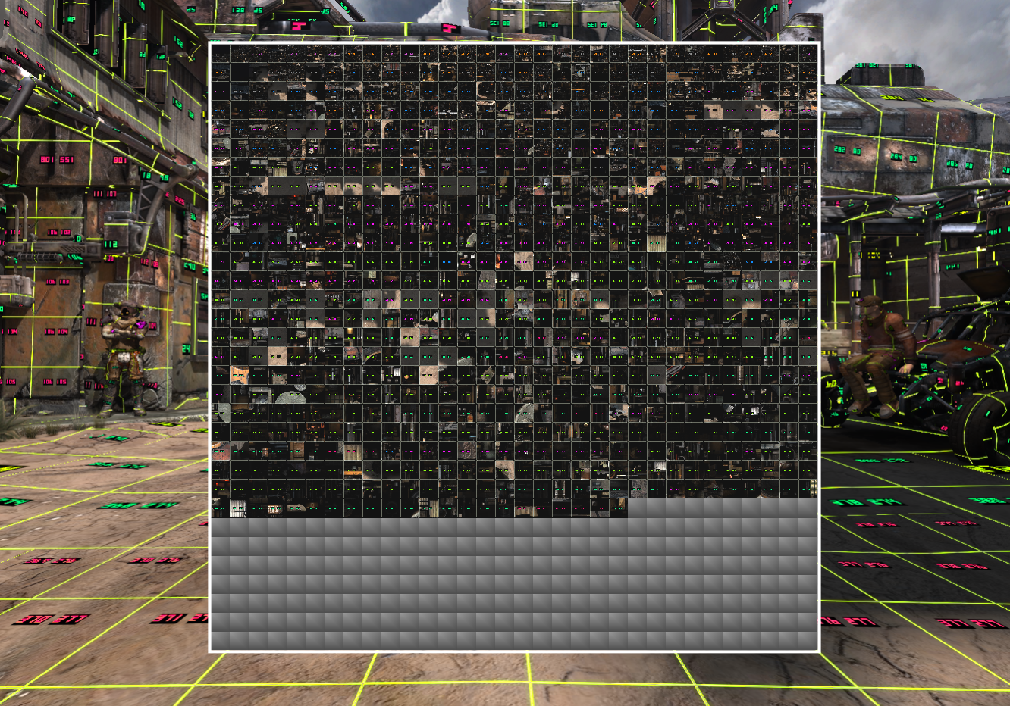
Software Virtual Textures in RAGE
Notes:
This shows the physical texture with all the currently resident texture pages.
The numbers are tiny but the same numbers that are visible on the virtual pages in the scene are displayed on the pages in the physical texture.

Slide 6
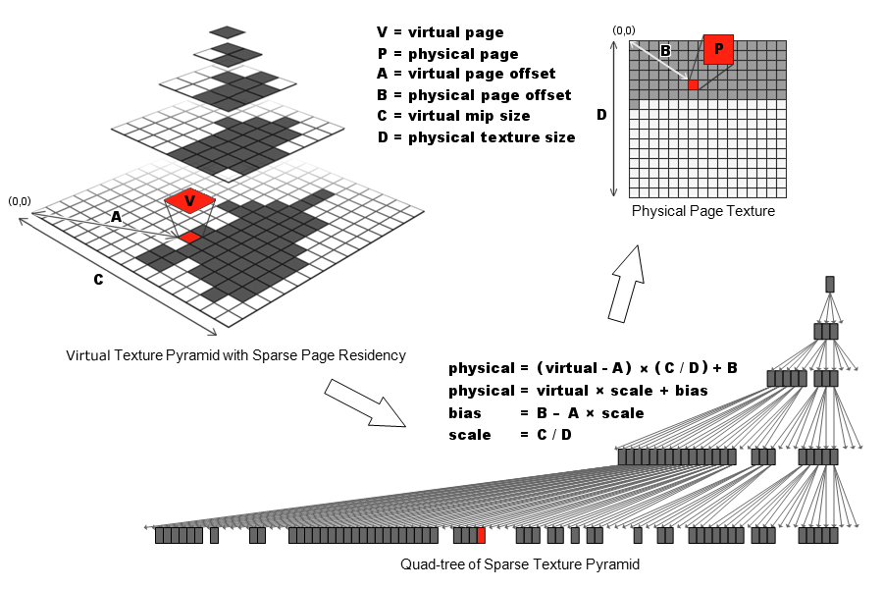
Address Translation
Notes:
Top left is the virtual texture.
Top right is the physical texture.
Bottom right displays the quad-tree that represents the mip hierarchy of the currently resident texture pages.
One of the resident texture pages of the virtual texture is highlighted in red (called V).
The same page is highlighted red in quad-tree and in the physical texture (called P).
Each quad-tree node provides a scale and bias that translates a virtual address within a virtual page to a physical address within a physical page.
The scale is the ratio between the size of the virtual mip level (C) and the size of the physical texture (D).
The bias is the offset to the physical page in the physical texture (B) minus the scaled offset to the virtual page in the virtual mip level (A).
Need only one scale value if virtual and physical textures are square. Need two scale values if virtual or physical texture is not square.
Need two bias values to map virtual pages to arbitrary physical pages.
The address translation automatically falls back to the nearest resident coarser page by using the scale and bias stored at the final node found when walking the quad-tree to find the desired LOD.

Slide 7
Page Table Texture
Page table is typically a texture with one texel per virtual page where each texel stores a mapping from a virtual page to a physical page.
A page table texture effectively stores the complete quad-tree whether pages are resident or not.
The page table texture stores a mapping to the nearest resident coarser texture page for any virtual page that is not resident.
By using a FP32x4 texture the page table can store the mapping from virtual to physical space as a simple scale and bias.
Other, more memory efficient page tables (5:6:5 etc.) are typically used in practice.

Slide 8
Page Table Sampling Issue
Page table must be point sampled.
Blending adjacent, completely independent mappings makes no sense.
Hardware page table lookup unaware of anisotropic lookup that follows.
Texture LODs for point sampling and anisotropic sampling are different.
Typically end up with mapping to texture page that is too coarse.
Not enough texture detail for the anisotropic texture filter.

Slide 9
Page Table Sampling Solution
RAGE uses fixed page table LOD bias of “- log2( maxAniso )”.
Results in appropriate detail on surfaces at oblique angle to view with maximized sample footprint (anisotropic).
Causes aliasing on surfaces orthogonal to view with minimized sample footprint (isotropic).
Real solution is to calculate correct page table LOD in fragment program based on anisotropy.

Slide 10
Page Table LOD Calculation
const float maxAniso = 4;
const float maxAnisoLog2 = log2( maxAniso );
const float virtPagesWide = 1024;
const float pageWidth = 128;
const float pageBorder = 4;
const float virtTexelsWide = virtPagesWide * ( pageWidth - 2 * pageBorder );
vec2 tc = virtCoords.xy * virtTexelsWide;
vec2 dx = dFdx( tc );
vec2 dy = dFdy( tc );
float px = dot( dx, dx );
float py = dot( dy, dy );
float maxLod = 0.5 * log2( max( px, py ) ); // log2(sqrt()) = 0.5*log2()
float minLod = 0.5 * log2( min( px, py ) );
float anisoLOD = maxLod - min( maxLod - minLod, maxAnisoLog2 );

Slide 11
Page Table LOD Calculation
Equivalent to “textureQueryLod()”.
However, “textureQueryLod()” uses a texture.
There is no virtual texture.
Use page table texture instead.
Page table texture “page payload” times smaller than virtual texture.
Must bias “textureQueryLod()” result with “log2( page payload )”.

Slide 12
Anisotropic Filtering Issue
RAGE uses physical textures without mip maps.
Anisotropic filter uses single mip level (bilinear samples).
Results in shimmering / aliasing.
Does not allow gradually blending in detail when new texture page is made resident.

Slide 13
Anisotropic Filtering Solutions
Add one mip level to the physical textures.
Use two virtual to physical translations and two physical texture lookups and blend between results.

Slide 14
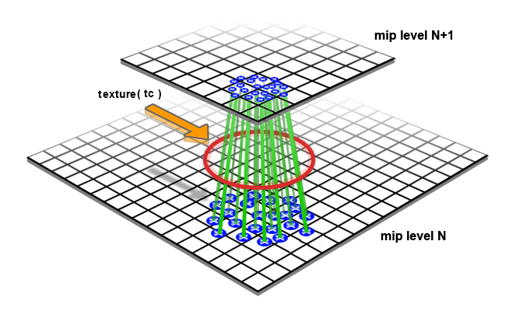
Normal Trilinear Anisotropic
Notes:
The red circle represents the anisotropic filter footprint and the green lines with blue end points represent the sampling pattern.
Not a realistic footprint or realistic sampling pattern but that’s irrelevant here.

Slide 15
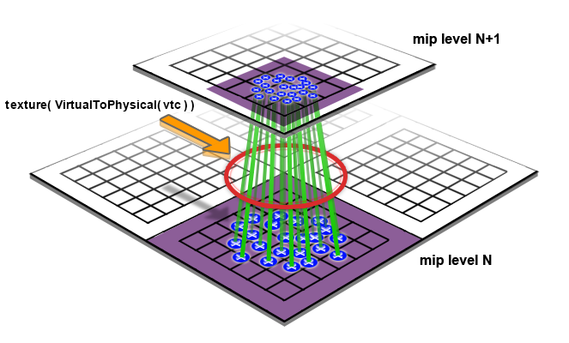
Mip Mapped Physical Texture
Notes:
25% additional memory needed for physical textures.
25% increase in texture update/upload bandwidth.
When using block compression there is no smooth transition from coarser virtual mip to coarser physical mip.
Coarser physical mip page is offset by 2 texels due to 4 texel border which results in different block compression artifacts.

Slide 16
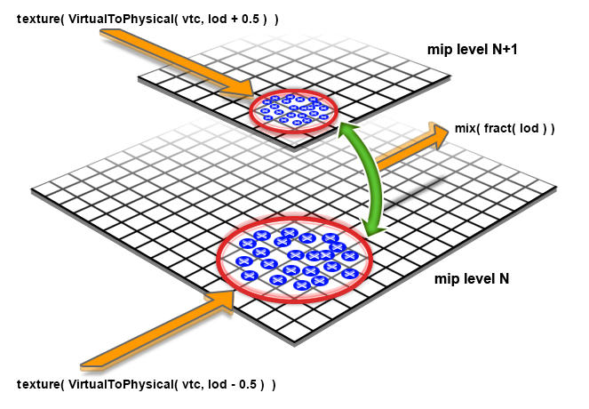
Two Anisotropic Physical Lookups
Notes:
Physical texture has no mip maps.
No increase in memory footprint.
Double the number of texture lookups.

Slide 17
Two Anisotropic Physical Lookups
vec4 scaleBias1 = textureLod( pageTable, virtCoords.xy, anisoLOD - 0.5 );
vec4 scaleBias2 = textureLod( pageTable, virtCoords.xy, anisoLOD + 0.5 );
vec2 physCoords1 = virtCoords.xy * scaleBias1.xy + scaleBias1.zw;
vec2 physCoords2 = virtCoords.xy * scaleBias2.xy + scaleBias2.zw;
vec4 color1 = texture( physicalTexture, physCoords1 );
vec4 color2 = texture( physicalTexture, physCoords2 );
color = mix( color1, color2, fract( anisoLOD ) );

Slide 18
Texture Popping Issue
Delay between texture page needed for rendering and residency.
Even with a highly optimized pipeline a delay may be unavoidable:
Texture data may be streamed from hard disk, optical disk, Internet etc.
Texture data may need to be transcoded.
Unpleasant “pop” when delayed texture page suddenly becomes resident.

Slide 19
Texture Popping Solutions
Predict required texture pages well ahead of time.
Hard to predict visible texture data in interactive environment.
Highly variable delays (optical disk seek times, Internet lag).
Gradually blend in delayed texture pages.
Far less distracting than sudden “pop”.

Slide 20
Clamp LOD with Min-LOD Texture
const float maxVirtMipLevels = 16;
float clampLOD = texture( minLodTexture, virtCoords.xy ).x * maxVirtMipLevels;
anisoLOD = max( anisoLOD, clampLOD );
Notes:
Min-LOD texture is non-mip-mapped and has one texel per finest virtual texture page.
Min-LOD texture is updated real-time to gradually clamp less and less and reveal more and more detail.

Slide 21
Software Virtual Texture Sampling
const float maxAniso = 4;
const float maxAnisoLog2 = log2( maxAniso );
const float virtPagesWide = 1024;
const float pageWidth = 128;
const float pageBorder = 4;
const float virtTexelsWide = virtPagesWide * ( pageWidth - 2 * pageBorder );
vec2 tc = virtCoords.xy * virtTexelsWide;
vec2 dx = dFdx( tc );
vec2 dy = dFdy( tc );
float px = dot( dx, dx );
float py = dot( dy, dy );
float maxLod = 0.5 * log2( max( px, py ) ); // log2(sqrt()) = 0.5*log2()
float minLod = 0.5 * log2( min( px, py ) );
float anisoLOD = maxLod - min( maxLod - minLod, maxAnisoLog2 );
uniform sampler2D pageTable; // RGBA-FP32 - { scaleS, scaleT, biasS, biasT }
uniform sampler2D minLodTexture; // R-8 - { minimum-LOD }
uniform sampler2D physicalTexture; // RGBA-8 - { red, green, blue, alpha }
in vec4 virtCoords; // virtual texture coordinates
out vec4 color; // output color
void main()
{
}
const float maxVirtMipLevels = 16;
float clampLOD = texture( minLodTexture, virtCoords.xy ).x * maxVirtMipLevels;
anisoLOD = max( anisoLOD, clampLOD );
Calculate Page Table LOD
Clamp LOD with Min-LOD Texture
vec4 scaleBias1 = textureLod( pageTable, virtCoords.xy, anisoLOD - 0.5 );
vec4 scaleBias2 = textureLod( pageTable, virtCoords.xy, anisoLOD + 0.5 );
vec2 physCoords1 = virtCoords.xy * scaleBias1.xy + scaleBias1.zw;
vec2 physCoords2 = virtCoords.xy * scaleBias2.xy + scaleBias2.zw;
vec4 color1 = texture( physicalTexture, physCoords1 );
vec4 color2 = texture( physicalTexture, physCoords2 );
color = mix( color1, color2, fract( anisoLOD ) );
Trilinear Anisotropic Filtering
Notes:
That’s quite a bit of code to fetch just a color from a software virtual texture.
No need to duplicate all this work to fetch more than just color (diffuse, specular, normal etc.).
Just allocate and maintain multiple physical textures, one for each texture map (diffuse, specular, normal etc.) and always make virtual pages with the same address resident at the same location in every physical texture.
Still have to sample each physical textures twice and blend the results for trilinear anisotropic filtering.

Slide 22
Hardware Virtual Textures
Also known as Partially Resident Textures (PRTs).
Integration, solving issues and achieving high quality.

Slide 23
Hardware Virtual Texture Sampling
uniform sampler2D virtualTexture; // RGBA-8 - { red, green, blue, alpha }
in vec4 virtCoords; // virtual texture coordinates
out vec4 color; // output color
void main()
{
int code = sparseTexture( virtualTexture, virtCoords.xy, color );
}

Slide 24
Fall Back To Resident Texture Data
if ( !sparseTexelResident( code ) ) {
float sampleLOD = textureQueryLod( virtualTexture, virtCoords.xy ).x;
for ( sampleLOD = ceil( sampleLOD ); sampleLOD <= 8.0; sampleLOD += 1.0 ) {
code = sparseTextureLod( virtualTexture, virtCoords.xy, sampleLOD, color );
if ( sparseTexelResident( code ) ) {
break;
}
}
}
if ( sampleLOD > 8.0 ) {
color = vec4( 0, 0, 0, 0 );
}

Slide 25
Hardware Virtual Texture Sampling
uniform sampler2D minLodTexture; // R-8 - { minimum-LOD }
uniform sampler2D virtualTexture; // RGBA-8 - { red, green, blue, alpha }
in vec4 virtCoords; // virtual texture coordinates
out vec4 color; // output color
void main()
{
}
float anisoLOD = textureQueryLod( virtualTexture, virtCoords.xy ).x;
const float maxVirtMipLevels = 16;
float clampLOD = texture( minLodTexture, virtCoords.xy ).x * maxVirtMipLevels;
anisoLOD = max( anisoLOD, clampLOD );
Calculate Desired LOD
int code = sparseTextureLod( virtualTexture, virtCoords.xy, sampleLOD, color );
Clamp LOD with Min-LOD Texture
if ( !sparseTexelResident( code ) ) {
for ( sampleLOD = ceil( sampleLOD ); sampleLOD <= 8.0; sampleLOD += 1.0 ) {
code = sparseTextureLod( virtualTexture, virtCoords.xy, sampleLOD, color );
if ( sparseTexelResident( code ) ) {
break;
}
}
}
if ( sampleLOD > 8.0 ) {
color = vec4( 0, 0, 0, 0 );
}
Trilinear Anisotropic Texture Fetch
Fall Back To Resident Data
Notes:
That’s still a fair bit of work to fetch a color from a hardware virtual texture.
Once again no need to duplicate all this work to fetch more than just color (diffuse, specular, normal etc.).
Just allocate and maintain multiple virtual textures simultaneously.
Only need to sample the additional virtual textures once at the end when the resident LOD is known.

Slide 26
Borderless Texture Pages
Software virtual textures perform virtual to physical address translation before sampling.
Software virtual texture pages need borders because texture unit samples a single page.
Hardware virtual textures perform virtual to physical translation during sampling.
Hardware virtual texture pages do not need borders because texture unit can sample from multiple pages.

Slide 27
Borderless Texture Page Issue
RAGE stores texture pages with borders on disk because it significantly simplifies the pipeline.
Need to support both software and hardware virtual textures because not all hardware supports PRTs.

Slide 28
Borderless Texture Page Solutions
Ship two virtual textures, one with and one without borders.
That’s a whole lot of data.
Strip borders at run-time by upsampling 120 payload to 128.
Non-integer up-sampling ratio causes noticeable blurring.
Composite borderless pages from multiple pages with borders at run-time (or vice versa).
Complicates the pipeline and introduces significant overhead.
Convert virtual textures with borders to ones without borders at install time.
De-re-compressing texture data may introduce additional compression artifacts.

Slide 29
Hardware Virtual Texture Size Limit
Floating-point precision limits software virtual texture sizes but they can go up to 256k x 256k texels (and beyond).
Hardware virtual textures are currently limited to 16k x 16k texels.
DirectX limits textures to 16k x 16k texels.
DirectX requires 8-bits of sub-texel and sub-mip precision on texture filtering.

Slide 30
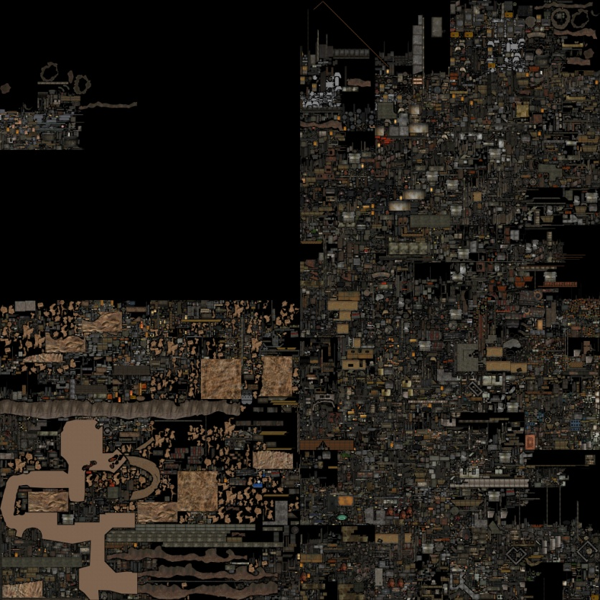
Example 64k x 64k Virtual Texture

Slide 31
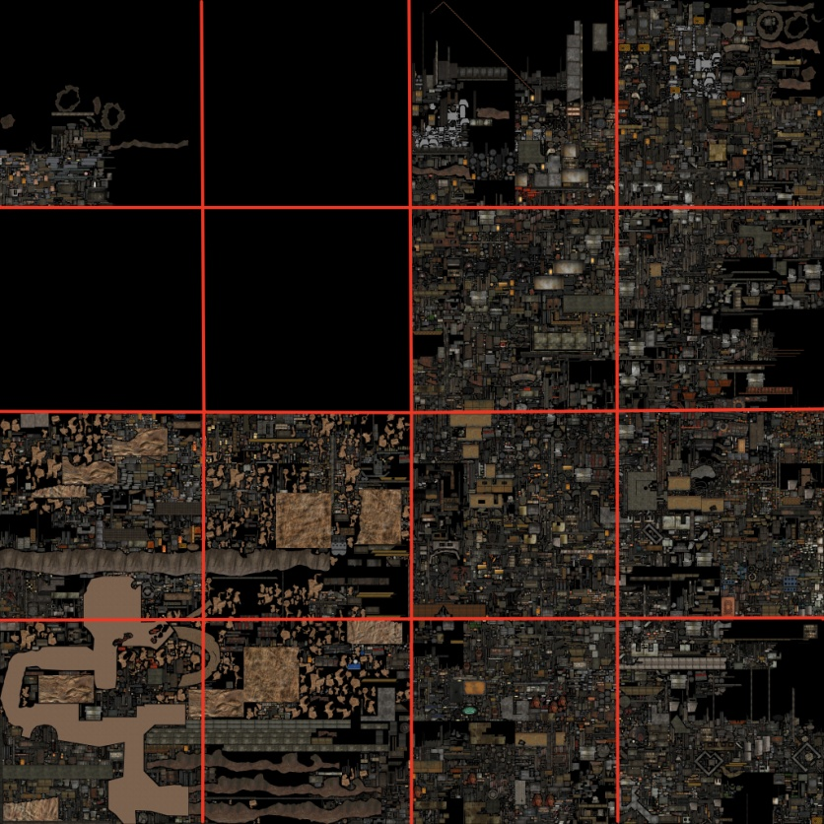
Partially Resident Texture Array

Slide 32
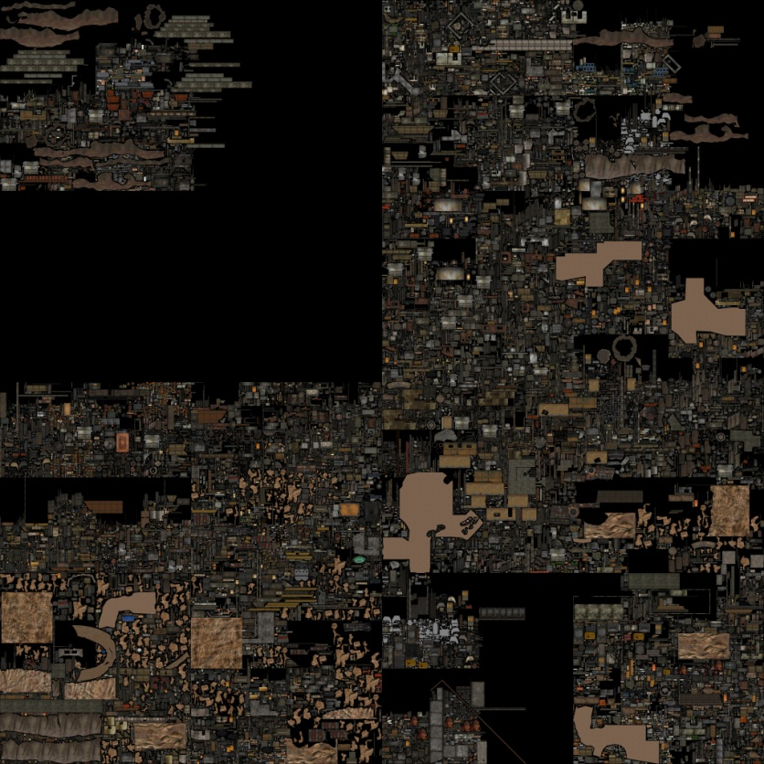
Split Texture Islands > 16k
?

Slide 33
Texture Array Coordinate Calculation
// convert 120-texel + border texture coordinates to 128-texel borderless ones
vec2 borderlessCoords = virtCoords.xy * 120.0 / 128.0;
// scale coordinates such that the fractional part addresses a single layer of the texture array
const float widthInPRTs = 4;
float2 layerCoords = borderlessCoords.xy * widthInPRTs;
// split the coordinates into a texture array index and layer coordinates
vec3 arrayCoords;
arrayCoords.xy = fract( layerCoords.xy );
arrayCoords.z = floor( layerCoords.y ) * widthInPRTs + floor( layerCoords.x );

Slide 34
Hardware Virtual Texture Array Sampling
vec2 borderlessCoords = virtCoords.xy * 120.0 / 128.0;
const float widthInPRTs = 4;
float2 layerCoords = borderlessCoords.xy * widthInPRTs;
vec3 arrayCoords;
arrayCoords.xy = fract( layerCoords.xy );
arrayCoords.z = floor( layerCoords.y ) * widthInPRTs + floor( layerCoords.x );
uniform sampler2D minLodTexture; // R-8 - { minimum-LOD }
uniform sampler2DArray virtualTexture; // RGBA-8 - { red, green, blue, alpha }
in vec4 virtCoords; // virtual texture coordinates
out vec4 color; // output color
void main()
{
}
float anisoLOD = textureQueryLod( virtualTexture, arrayCoords.xy ).x;
const float maxVirtMipLevels = 16;
float clampLOD = texture( minLodTexture, borderlessCoords.xy ).x * maxVirtMipLevels;
anisoLOD = max( anisoLOD, clampLOD );
Calculate Texture Array Coordinates
int code = sparseTextureLod( virtualTexture, arrayCoords.xyz, sampleLOD, color );
Calculate Desired LOD
if ( !sparseTexelResident( code ) ) {
for ( sampleLOD = ceil( sampleLOD ); sampleLOD <= 8.0; sampleLOD += 1.0 ) {
code = sparseTextureLod( virtualTexture, arrayCoords.xyz, sampleLOD, color );
if ( sparseTexelResident( code ) ) {
break;
}
}
}
if ( sampleLOD > 8.0 ) {
color = vec4( 0, 0, 0, 0 );
}
Clamp LOD with Min-LOD Texture
Trilinear Anisotropic Texture Fetch
Fall Back To Resident Data
Notes:
That’s a fair bit of code.
The texture array coordinates could be stored on the geometry but we want to simultaneously support software and hardware virtual textures.
Besides the full virtual texture coordinates may still be needed to calculate feedback.

Slide 35
Hardware Virtual Texture Page Sizes
PRT pages do not have a fixed size in texels.
PRT pages have a fixed size in memory.
On current AMD hardware the PRT pages are always 64 kB.
Format | Size in Texels
uncompressed RGBA-8 | 128 x 128 texels
DXT5/BC3 compressed | 256 x 256 texels
DXT1/BC1 compressed | 512 x 256 texels
Notes:
While with software virtual textures we have complete control over the size of a texture page, with hardware virtual textures we do not.

Slide 36
Supporting Different Page Sizes
Support for uncompressed and compressed PRTs is desirable.
Virtual texture page size on disk is 128 x 128.
Maps directly to an uncompressed PRT page.
Integer multiple of on disk pages used to create a compressed PRT page.

Slide 37
PRT Page Management
TexSubImage used to both simultaneously upload texture data and update page tables.
Need the texture data before calling TexSubImage.
Only after TexSubImage was called you know whether physical memory was available.
Getting the texture data ready may require significant effort (streaming, transcoding etc.) only to find out no more physical memory is available.

Slide 38
PRT Page Management
Undesirable to drop page or free up memory last minute after TexSubImage fails.
Need to know if physical memory is available first so memory can be freed up early on.
Extensions to separate page table update from texture page allocation + population are being worked on.
Notes:
Especially with a highly parallel deep pipeline it is undesirable to learn we are out of memory at the very end.
In our case we either have to roll back all the work that came through the pipeline or we have to free up a page in the middle of issuing TexSubImage commands which would be bad for rendering performance.

Slide 39
Are PRTs worth the trouble?
PRTs do not need pages with borders.
Simplifies things everywhere.
The number of resident PRT pages is not limited by the size of a physical textures.
All available video memory can be used.
PRTs support proper high quality texture filtering.
The anisotropic footprint not limited by page border size.

Slide 40
Increasing Texture Detail
Uniquely textured worlds require a lot of storage and bandwidth.
Can only reasonably ship so much detail to consumer (DVD, BluRay, Digital-download).

Slide 41
Solutions for More Texture Detail
Stream detail at run-time over the Internet.
Must be online to experience virtual world.
Enhance detail with detail textures.
Specialized form of texture compression.
Limited variety and creation, selection, run-time cost.
Programmatically enhance texture detail.
Virtual textures are well suited for efficient programmatic texture enhancement.

Slide 42
Virtual Texture Upsampling
Allocate a software virtual texture or PRT much larger than the virtual texture stored on disk.
Upsample a coarser texture page to populate a texture page for which no original content is stored on disk.
As opposed to upsampling (or magnifying) for every pixel in a fragment program the cost is amortized by upsampling once when a page is made resident.
Can use various interesting upsampling algorithms. (bicubic, Sinc, sharpening, edge enhancing etc.)

Slide 43

Virtual Texture Upsampling Example
Notes:
This shows a textured wall with bilinear magnification.

Slide 44

Virtual Texture Upsampling Example
Notes:
This shows the same textured wall with programmatically generated finer mip texture pages.
In this particular case the upsampling algorithm uses a bicubic filter with adaptive sharpening.
It is a subtle improvement which is good because we don’t want to mangle the original art.
At the same time it definitely looks better than bilinear magnification.
Ok, so you implemented some lame upsampling algorithm… that’s not the point.

Slide 45
Upsampling Avoids Bilinear Magnification
Not relying on standard bilinear magnification because new texture data is generated as the viewer approaches a textured surface.
Need less bits of sub-texel precision on texture filtering.
This frees up bits that can be used to support larger textures.
Notes:
If only we can tell the hardware where to place the fixed point we don’t need more bits.
Presumably it is cheaper to make the hardware work with a user specified fixed point than it is to add more bits.

Slide 46
Populating Virtual Textures
Populating a virtual texture currently faces significant API overhead.
In RAGE uploading texture data through the graphics driver may cost more than 6 milliseconds of CPU time per frame.
Texture updates are also synchronized with rendering when instead they could happen completely asynchronously.
Notes:
This has been a pet peeve for over a decade.

Slide 47
Direct Texture Access
Unified memory architectures are the future.
On the consoles we have had direct access to texture memory for years.
Direct access allows virtual texture pages to be updated asynchronously.
GPU texture caches may not be coherent with texture memory when directly writing to memory.
Page table and texture updates can be spaced far apart and texture caches are typically flushed frequently enough.
Extensions for direct texture access are being worked on.

Slide 48
Tiled Texture Formats
Tiled formats are used for improved memory access patterns and performance.
For direct texture access either use linear (non-tiled) or use known specified tiled format.
Direct texture access does not allow arbitrary tiling changes for new hardware/drivers.
Need standardized tiled formats.
Notes:
One of the arguments constantly used against direct texture access is that it doesn’t allow the hardware people to arbitrarily change the tiling format underneath an application.
While there may be a significant performance delta between linear (non-tiled) textures and tiled textures, the difference between different tiling formats really isn’t always what significant and quite often only important for synthetic benchmarks.

Slide 49
Course Resources
http://cesium.agi.com/massiveworlds/

